Slide 1
Visitor Counter By: Anthony Dinh & Michael Jurs CPE 329
June 5, 2015

Slide 2
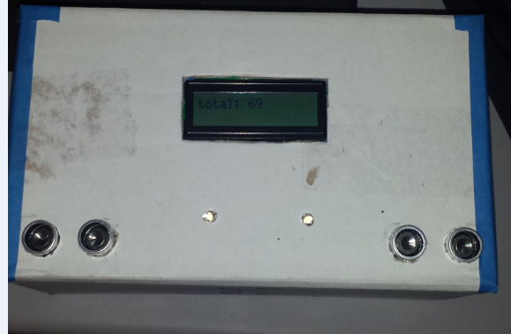

Slide 3
Idea
What does it do??
Counts the number of people entering and leaving the room
How does it work??
Uses two ultrasonic sensors that detects movement at a certain distance and determines if entering or leaving
Notes:
Penvenne helped give us idea

Slide 4
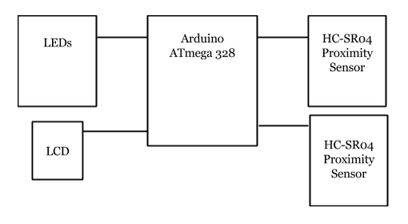
Black Box Diagram

Slide 5
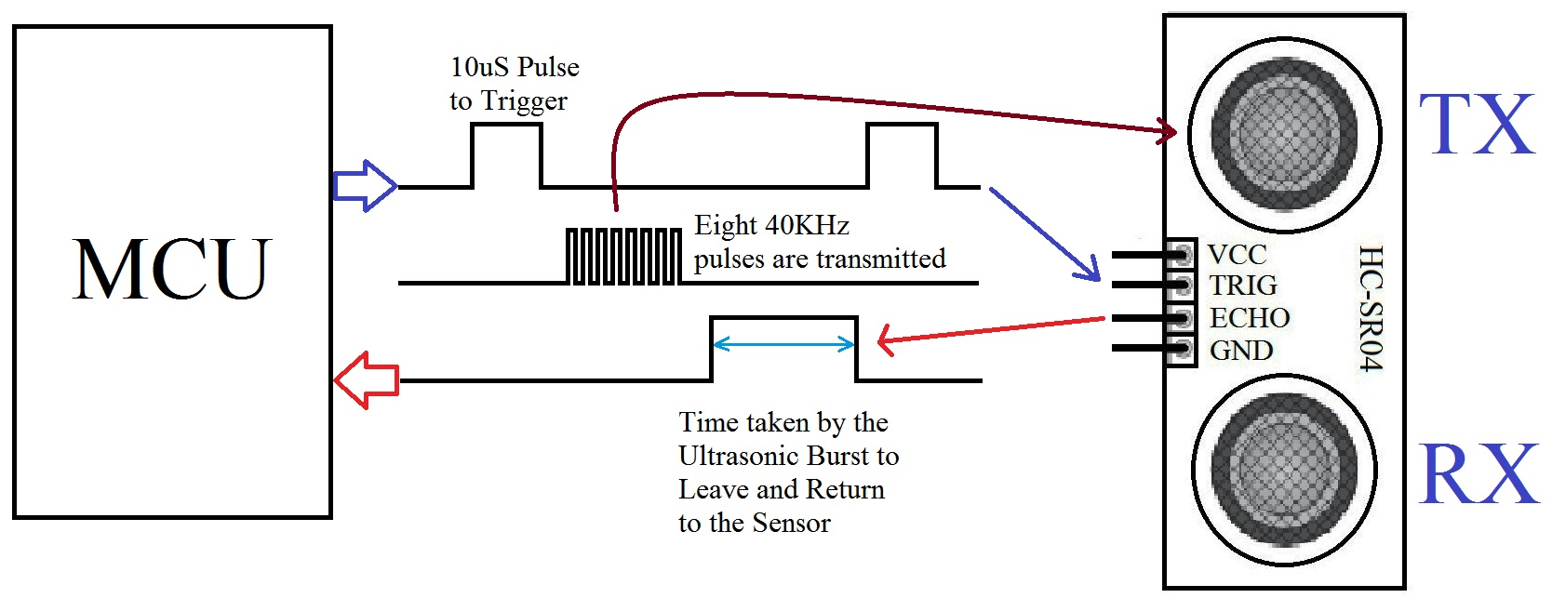
Hardware - HC-SR04 Ultrasonic Sensors
Notes:
2 HC-SR04, LCD,

Slide 6
Methods Used
2 Pin Change Interrupts on echo pins along with 2 timer interrupts
Polling during the rising and falling edge of echo
Notes:
first method used: 2 Pin Change Interrupts on echo pin along with 2 timer interrupts. (didn’t work and less consistent)
2nd method used: polling during the rising and falling edge of echo (more consistent with timing)

Slide 7
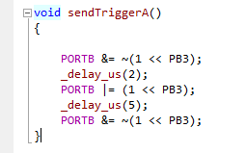
Software
Sending the pulse to trigger
Notes:
same as methods used?

Slide 8
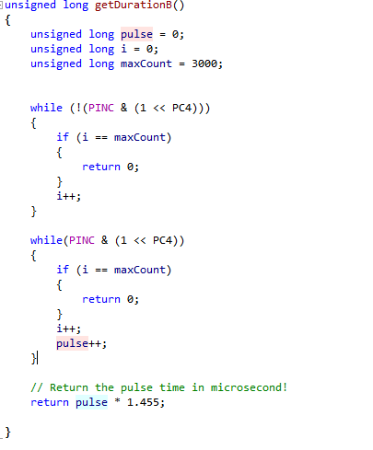
Software
Counting the duration of the pulse

Slide 9
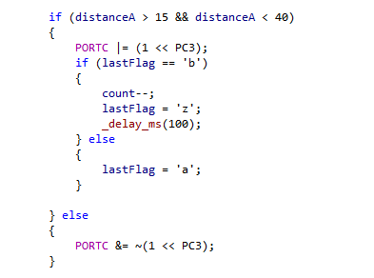
Software
Snippet of conditionals to determine if leaving or entering

Slide 10
Potential Improvements
Fix some random bugs that occur such as double counting
Try to count multiple people entering at same time
Read faster without doubling counting
Try to make our box design look even more trashy than it already is :)
Notes:
read faster, read larger distances, more stable, less buggy

Slide 11
Any Questions?

